Slide 1

Noun Clause ---Appositive Clause 名词性从句 之同位语从句

Slide 2
主语从句
表语从句
宾语从句
同位语从句
主语
表语
宾语
同位语
名词性从句

Slide 3

判断一下属于哪一种“名词性从句”？？？
Suddenly the thought came to me that he would go blind.

Slide 4

判断一下属于哪一种“名词性从句”？？？
The news that we are having a holiday tomorrow is not true.

Slide 5
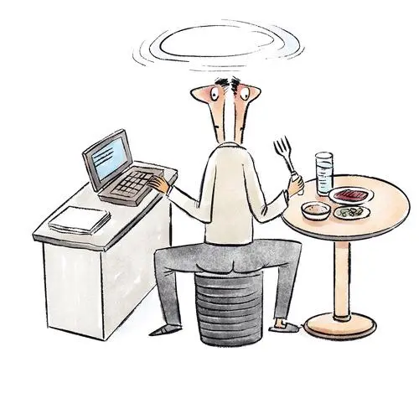
判断一下属于哪一种“名词性从句”？？？
The key is how to balance work and life.

Slide 6
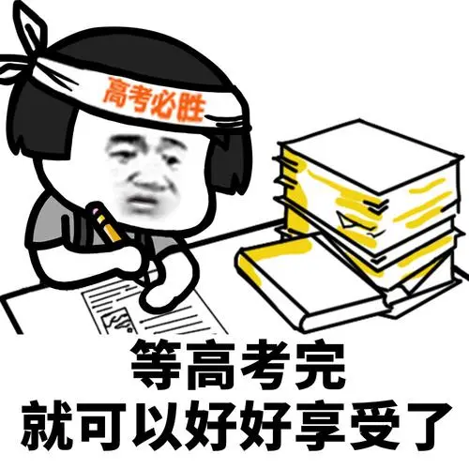
判断一下属于哪一种“名词性从句”？？？
He told me that he would go to the college the next year.

Slide 7
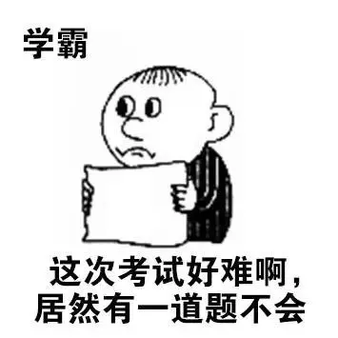
判断一下属于哪一种“名词性从句”？？？
That is why she pretended to fail the exam.

Slide 8
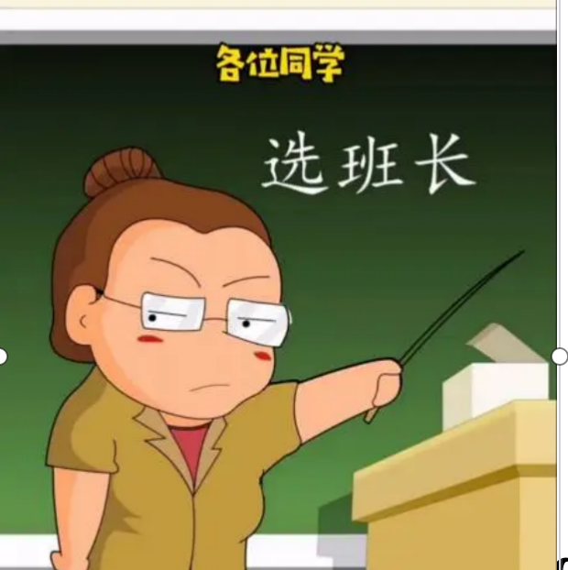
判断一下属于哪一种“名词性从句”？？？
Who will be our monitor hasn't been decided yet.

Slide 9
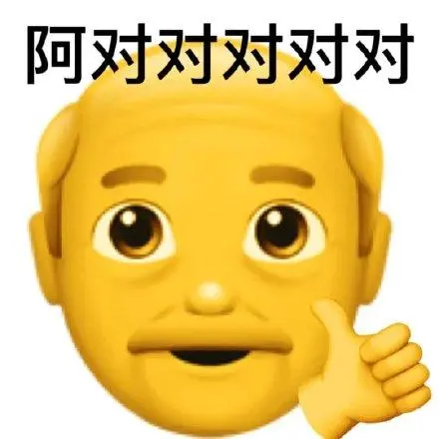
判断一下属于哪一种“名词性从句”？？？
Whatever you did is right.

Slide 10
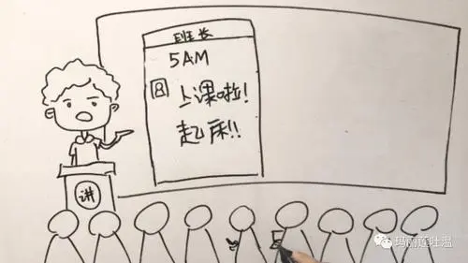
同位语的表现形式有以下几种：
名词
Tom, our monitor, is a handsome boy.

Slide 11
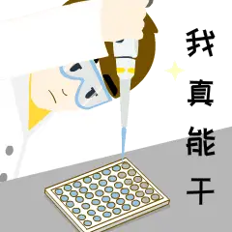
同位语的表现形式有以下几种：
代词
I myself will do the experiment.

Slide 12
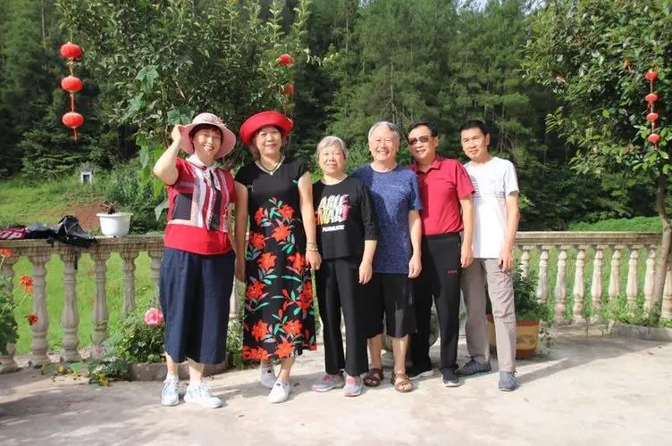
同位语的表现形式有以下几种：
She is the oldest among them six.
数词

Slide 13
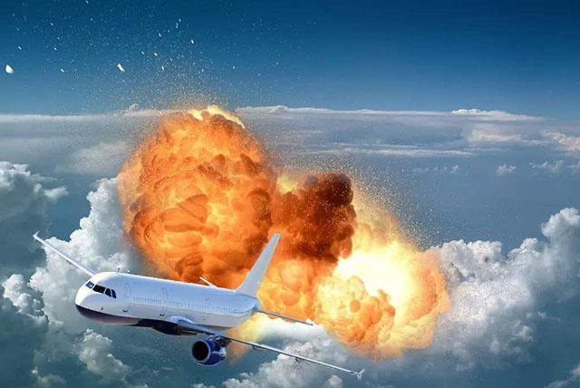
同位语的表现形式有以下几种：
He told me the news that the plane had exploded.
从句

Slide 14
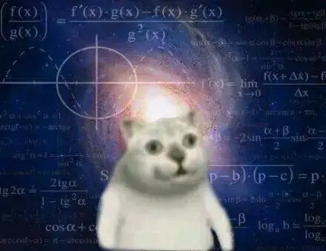
同位语的表现形式有以下几种：
Some subjects, such as maths and physics, are very difficult to learn.
such as 引导

Slide 15
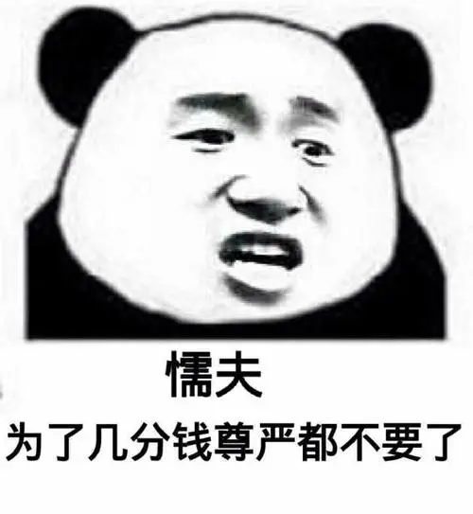
同位语的表现形式有以下几种：
Please don't get frightened, unless you're a mouse, that is, a coward person.
that is... 引导

Slide 16
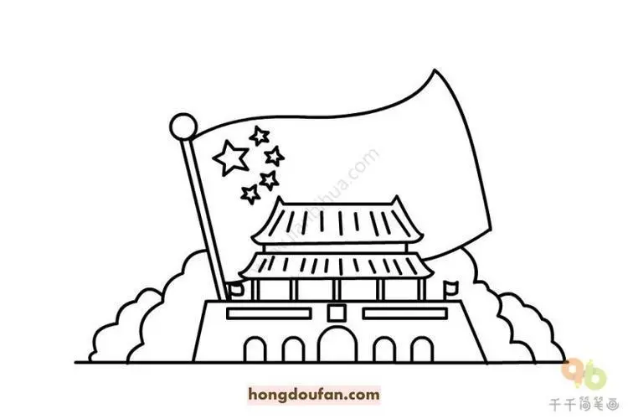
同位语的表现形式有以下几种：
The city of Beijing has been greatly changed since 2000.
of引导

Slide 17
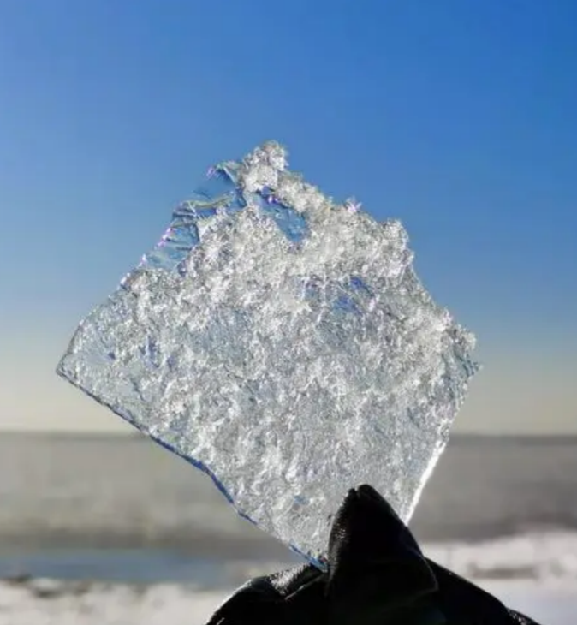
同位语的表现形式有以下几种：
The freezing temperature, or freezing point, is the temperature at which water freezes under ordinary pressure.
or引导

Slide 18

同位语的表现形式有以下几种：
He told us the good news, namely, the museum is open to all.
namely引导，翻译为“即”

Slide 19
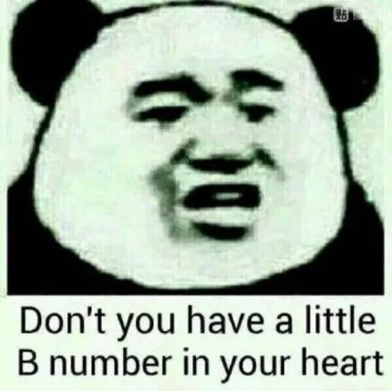
同位语的表现形式有以下几种：
There is only one way of improving your English , that is to say, to practice more.
that is to say引导，翻译为“那就是说”

Slide 20
同位语的表现形式有以下几种：
(8) 有时可用 namely (即), that is to say (也就是说), in other words (换句话说), that is (那就是), for example 等引出同位语, 说明其前面的名词或代词。有时同位语直接跟在名词或代词的后面。

Slide 21
同位语从句 the Appositive clause
做同位语，又是一个从句

Slide 22
一、定义
同位语从句一般放在____________ 的后面，用以 _______
名词所表示的具体内容。在句中作同位语。
某些抽象名词
解释或说明
二、常见的同位语从句的名词
fact, news, idea, promise, question, problem, doubt, fear, hope,
order, belief, thought, truth, suggestion, advice…

Slide 23
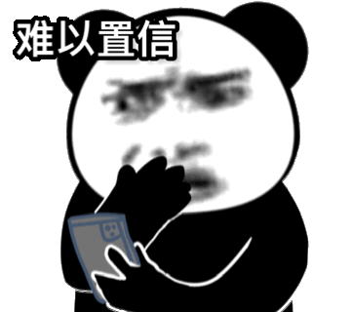
同位语从句引导词
that引导
The fact that you haven’t enough time to do the work is simply unbelievable.

Slide 24
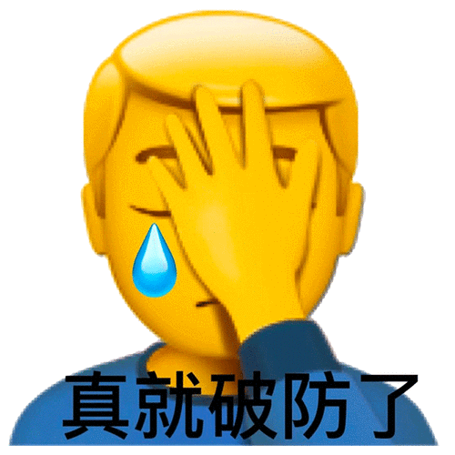
同位语从句引导词
that引导
The hope that he may come here is gone.
如同位语从句意义、结构完整，应用that引导同位语从句。
（即that 不充当任何成分，只起连接作用）

Slide 25

同位语从句引导词
whether引导
The question whether we need more time to do the work has not been discussed.

Slide 26
引导同位语从句的连接词
 | 功能 | 例词
从属 连词 | 只起连接作用，不充当从句中的任何成分。
连接 代词 | 既起连接作用，又在从句中担任成分。
连接 副词 | 既起连接作用，又在从句中担任状语。
that / whether

Slide 27
同位语从句引导词
I have no idea when they will go.
I have no impression how he went home, perhaps by bike.
I have no idea why she quit her job.
The news where the missing person has been found makes us happy.

Slide 28
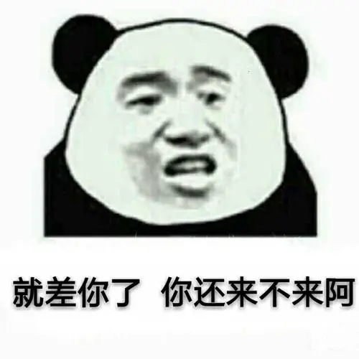
同位语从句引导词
whether引导
There was some doubt whether he would be able to come.
如同位语从句意义不完整，结构完整，需增加"是否"的含义，应用whether引导同位语从句。
（if不能引导同位语从句！！！！！）

Slide 29
如同位语从句意义不完整，需增加“什么时候”、“什么地点”、“什么方式”等含义
应用连接副词 when, where, why, how等词引导同位语从句。

Slide 30
引导同位语从句的连接词
 | 功能 | 例词
从属 连词 | 只起连接作用，不充当从句中的任何成分。
连接 代词 | 既起连接作用，又在从句中担任成分。
连接 副词 | 既起连接作用，又在从句中担任状语。
that / whether
when, where, why, how

Slide 31
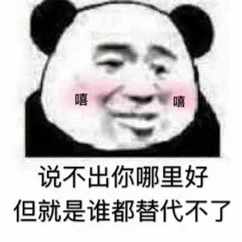
同位语从句引导词
who引导
The question who will take his place is still not clear.
缺“主语”

Slide 32
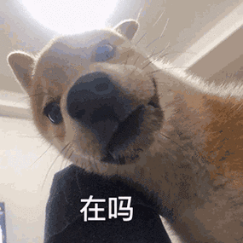
同位语从句引导词
what引导
I have no idea what he is doing.
缺“宾语”

Slide 33
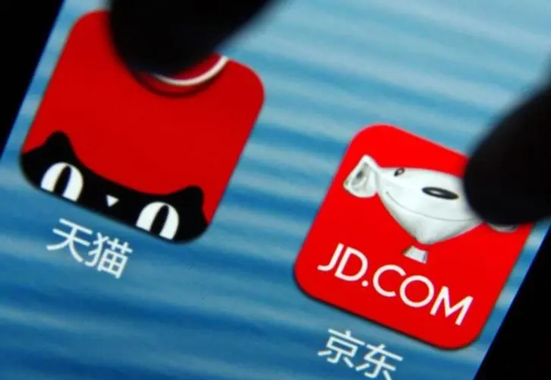
同位语从句引导词
whose引导
I have no idea whose company is better.
缺“定语”

Slide 34
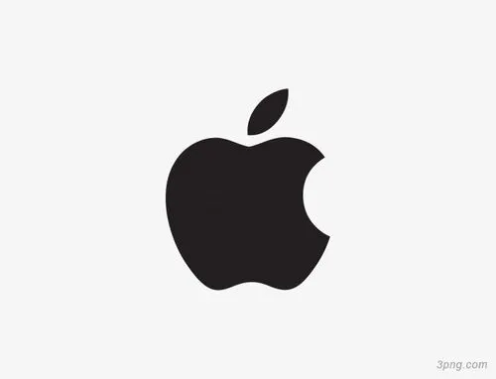
同位语从句引导词
which引导
Tim Cook has a company, which is a well-known multinational company and enjoys our praise.
如同位语从句成分不完整，根据所缺成分添加who, what, whose, which等词

Slide 35
引导同位语从句的连接词
 | 功能 | 例词
从属 连词 | 只起连接作用，不充当从句中的任何成分。
连接 代词 | 既起连接作用，又在从句中担任成分。
连接 副词 | 既起连接作用，又在从句中担任状语。
that / whether
who, which, what, whose
when, where, why, how

Slide 36
They expressed the hope _____ they would come over to visit China again.
I have no idea ________ they were able to get it done in so short a time.
Have you any idea _____ he is doing now?
They asked me the question ________the work was worth doing.
The question _____ should do the work requires consideration.
that
(不缺成分，意义完整)
whether
(不缺成分，意义不完整)
what
(缺“宾语”)
whether
(不缺成分，意义不完整)
(缺“主语”)
who

Slide 37
Exercise—Multiple choices
1. Here’s an announcement (公告) ____ the winner at chess can get a prize of 1,000 yuan.
A. that B. why C. whether D. when
2. It’s a question _____ he did it.
A. what B. that C. how D. if
3. The dream ____ we are flying in space has finally been realized by a Chinese astronaut Yang Liwei.
A. when B. that C. which D. what

Slide 38
Exercise—Multiple choices
4. They spread the rumor ____ a new school would be built.
A. that B. what C. where D. which
5. The question ____ it is right or wrong depends on the result.
A. if B. which C. that D. whether
6. I have a question ______ should take the responsibility.
A. that B. who C. what D. if
7. They expressed the suggestion _____ she accept the award.
A. what B. when C. that D. which

Slide 39

同位语从句有时被别的词把它和名词隔开：
注意:
The story goes that William killed the king with an arrow.
Word came that their team had won.

Slide 40
1. She wants to know what kind of films I like .
2. That is what I want to tell you.
3. Whether she will go there is not known.
4. It is a pity that he can't attend the party.
5. The teacher suggested that he (should) read the novel.
6. I will tell you why I was late for the meeting.
7. I wonder what has happened to her.
8. The reason is that he doesn’t understand me .
①主语从句 ②表语从句 ③ 宾语从句

Slide 41
同位语从句与定语从句的区别
A: 同位语从句说明的名词大都是抽象名词;
B: 定语从句所修饰、限定的名词或代词有抽象的有不抽象的。
fact, news, idea, promise, question, problem, doubt, fear, hope,
order, belief, thought, truth, suggestion, advice…

Slide 42
同位语从句与定语从句的区别
1.The reason why he left is still a puzzle.
2.The reason that you gave me is understanding.

Slide 43
同位语从句与定语从句的区别
A: 引导同位语从句的连词不可省略;
B: 引导定语从句的关系代词作宾语时常可省略。
1.The news that he has been elected monitor of our class is true.
2.The news that he told me is exciting.

Slide 44
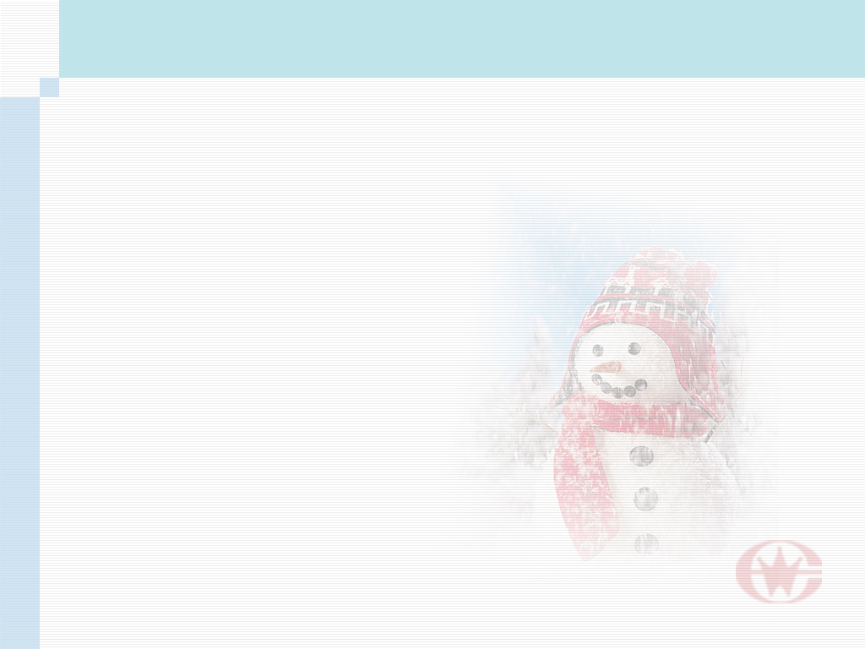
指出划线部分是同位语从句还是定语从句。
1. The fact that Great Britain is made up three countries is known to us.
2. The continent that consists of two countries is developing very fast.
(同位语从句)
(定语从句)

Slide 45
3. The news that the plane will take off on time makes everybody happy.
4. The news that is spreading around the country is that a heavy storm is coming.
(同位语从句)
(定语从句, 表语从句)

Slide 46
5. The suggestion that we should learn something practical is worth considering.
(同位语从句)

Slide 47
练一练！
1. The fact ____ she works hard is well known to us all. A. that B. what C. why D. which
2. The fact ____ he was successful proves his ability. A. that B. what C. which D. why
A
A

Slide 48
3. The news ____ he was kidnapped surprised us greatly. A. what B. that C. why D. when
4. His suggestion ____ the meeting was delayed was turned down. A. which B. that C./ D. it
B
B

Slide 49
5. I have no idea ____ he will start. A. when B. that C. what D./
6. I've come from the government with a message ____ the meeting won't be held tomorrow. A. if B. that C. whether D. which
A
B

Slide 50
7. The nurses are trying their best to reduce the patient's fear ____ he would die of the disease. A. that B. as
C. of which D. which
A

Slide 51
10. He often asked me the question ____ the work was worth doing. A. whether B. where
C. that D. when
A

Slide 52
13. Along with the letter was his promise ____ he would visit me this coming Christmas.
A. which B. that
C. what D. whether
B

Slide 53
14. Luckily, we'd brought a road map without ____ we would have lost our way.
A. it B. that C. this D. which
15. Do you have any idea ___ is actually going on in the classroom?
A. that B. what C. as D. which
D
B

Slide 54
16. One of the men held the view ___ the book said was right.
A. that B. what that
C. that what D. whether
C
that 引导同位语从句，补充说明view; what引导主语从句并在同位语从句中作主语。

Slide 55
17. There is a new problem involved in the popularity of private cars ___ road conditions need____.
A. that; to be improved
B. which; to be improved
C. where; improving
D. when; improving
A

Slide 56
18. I have no idea ____ we can spend our holiday.
A. where
B. which
C. that
D. what
A

Slide 57
19. The news ____ he told us yesterday is not true, but the news ____ our team has won the match is true.
A. /; that
B. that; /
C. that; which
D. that; who
A

Slide 58
20. The question occurred to me ____ the book was worth reading.
A. what
B. whether
C. which
D. if
B

